Slide 1
Integrating Microsoft PlayFab Services into Vanguard-Outrider Demo Game for Enhanced Player Experience
-by
Sreeja manikonda
Ganggenapalli Utthej Reddy
bolledula sai arun reddy

Slide 2
Microsoft PlayFab
Microsoft PlayFab is a backend platform for games that provides services such as player authentication, virtual item management, matchmaking, and more. It allows game developers to focus on creating engaging gameplay without worrying about server infrastructure. PlayFab also offers analytics and live operations tools to help developers understand and optimize their games.

Slide 3
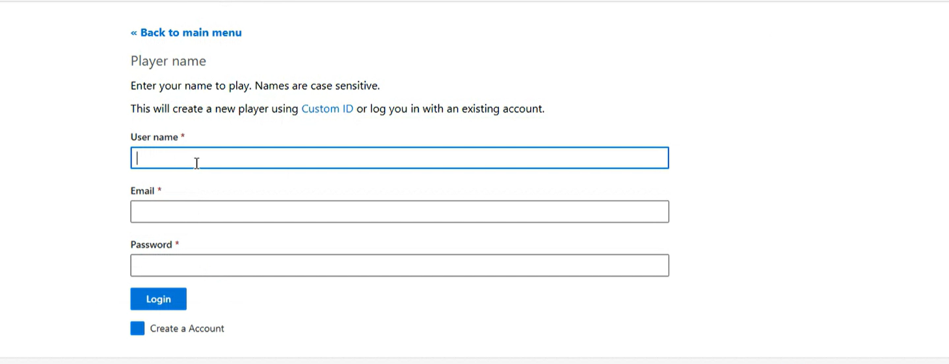
REGISTER PAGE
The above Page is custom page added to the page for Registration of the Player or login to the site.

Slide 4
Games:
Once the game is created in the Azure PlayFab then we have to copy the game id to the developed game and should be able to launch the game.
Once the player is register then the player will be authenticated to login if the credentials are correct then the player will be logged to the application.

Slide 5
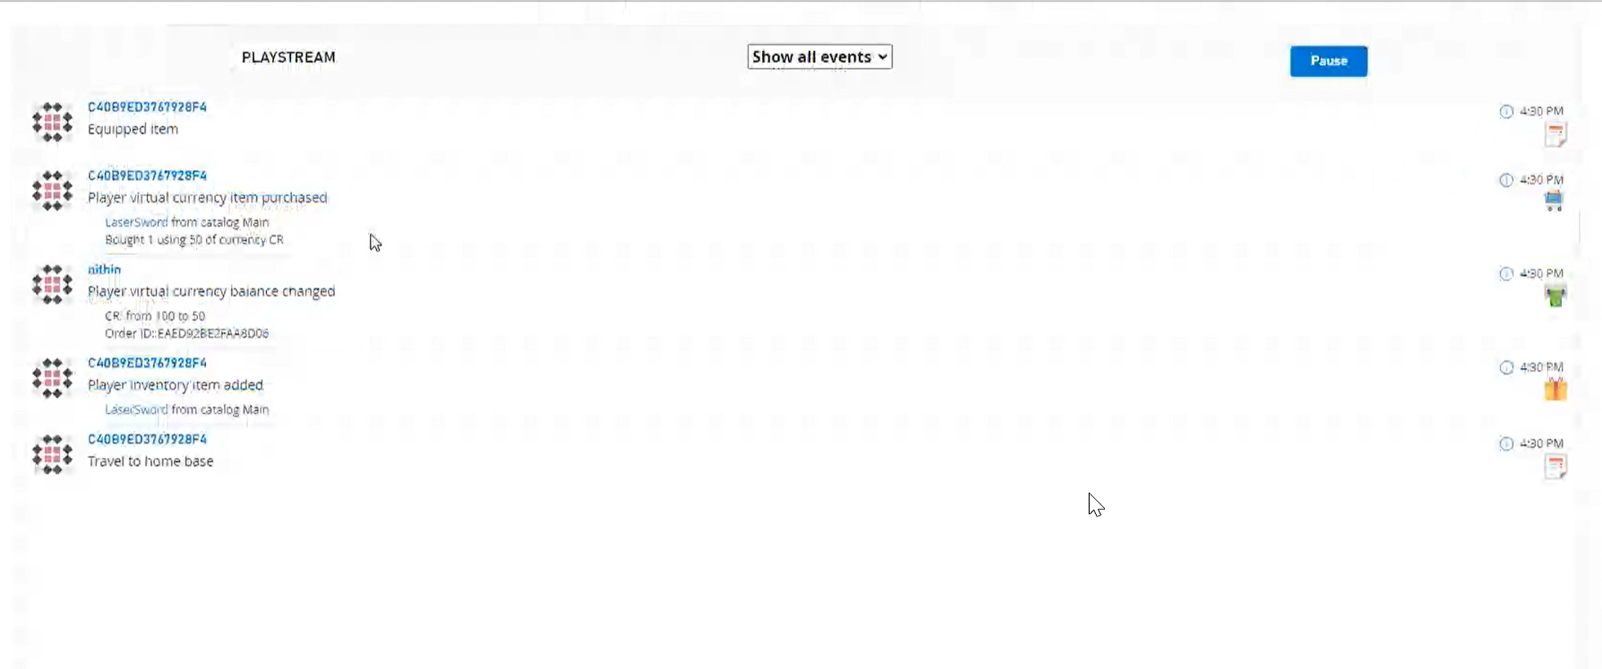
PlayStream:
PlayStream is a feature of Microsoft PlayFab that provides real-time analytics and event processing for games. It allows game developers to track player behavior, monitor game performance, and make data-driven decisions to improve the player experience. PlayStream can capture a wide variety of events, such as player logins, virtual item purchases, and in-game achievements, and provide insights into player engagement and retention. PlayStream also supports custom event types and can integrate with external analytics platforms.

Slide 6
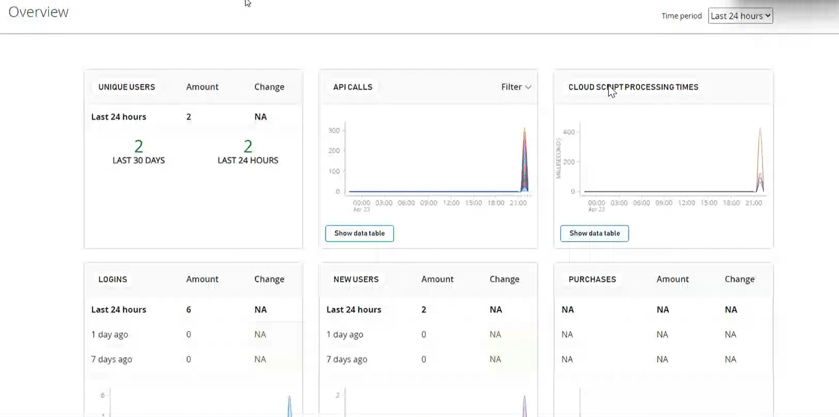
Statistics:

Slide 7
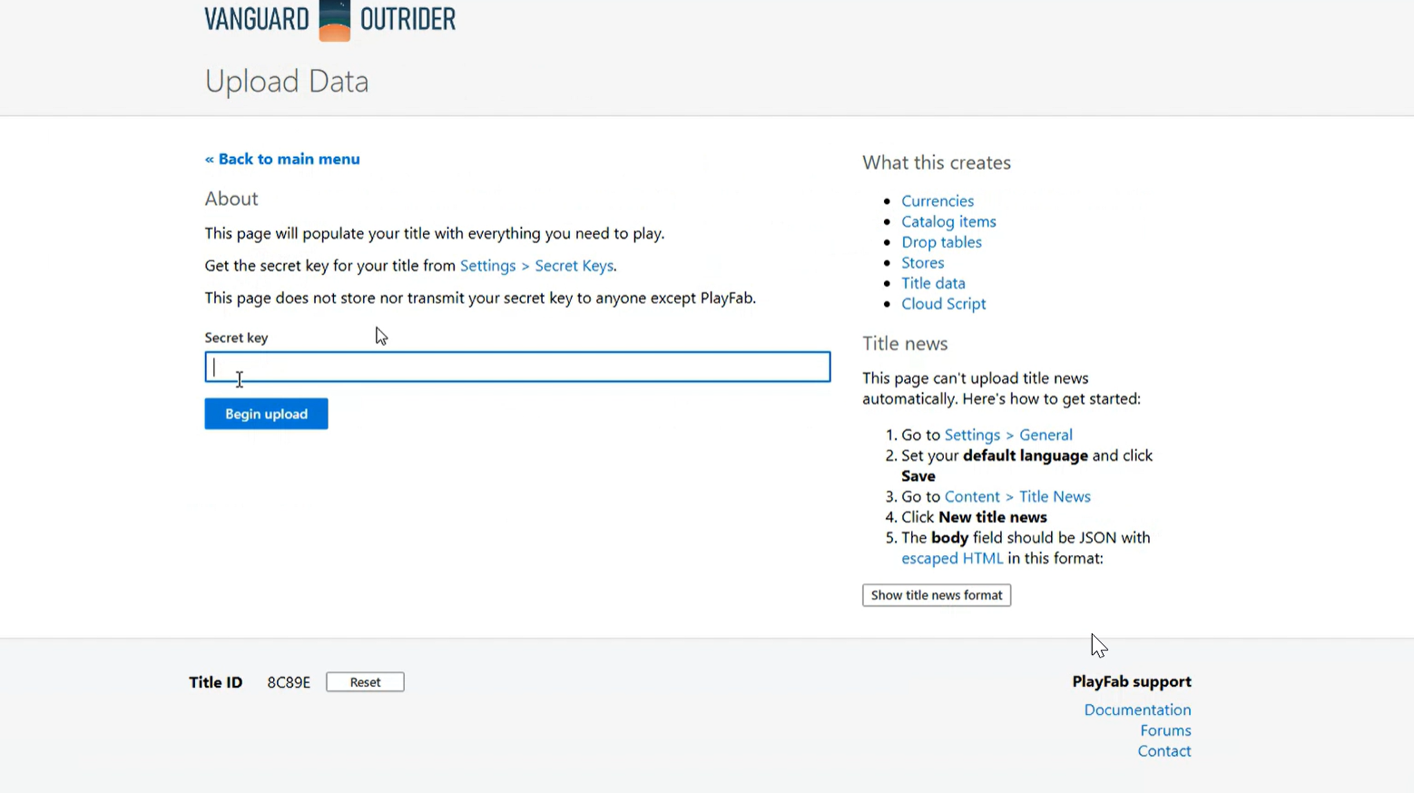
Uploading Game Data:

Slide 8
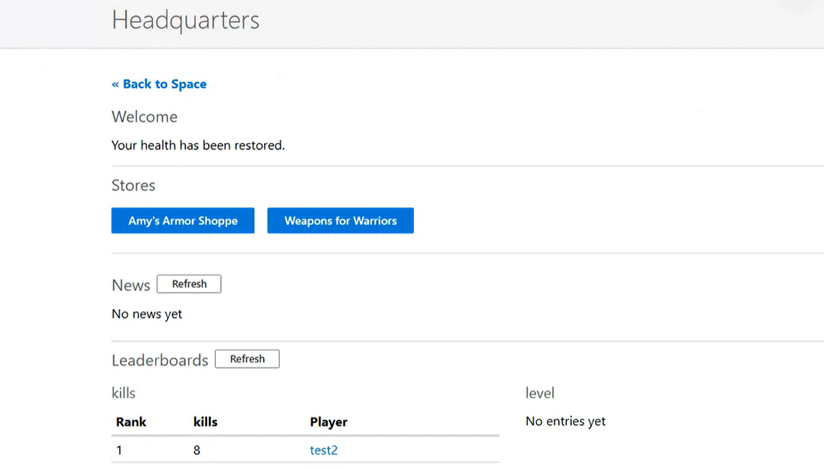
Leader board:

Slide 9
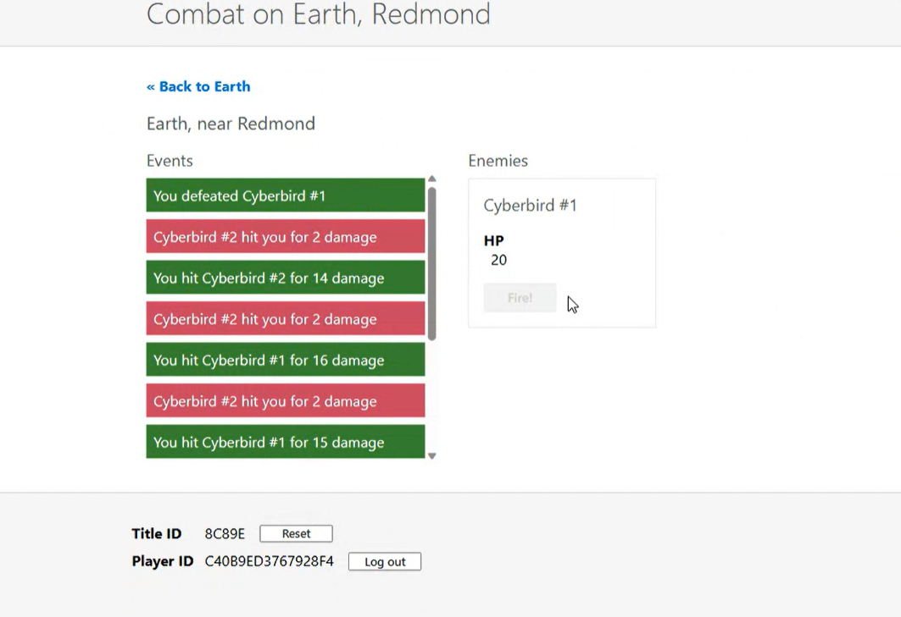
Game Play:

Slide 10
Challenges Faced:
Implementing PlayFab can be challenging due to its complex platform, integration requirements, security concerns, cost considerations, and reliance on support resources. However, successful implementation can provide game developers with powerful tools to manage player accounts, virtual currencies, and improve player engagement.

Slide 11
Thank you

